Slide 1
Simpsons Image Colorization using cGAN and PatchGAN
Alexandra Hotti, Jacob Malmberg, Marcus Nystad Öhman
Notes:
jnm. Presentera oss. b h

Slide 2
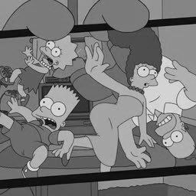
Introduction- automatic image colorization
colorizing grayscale images
Using GANS
possible applications:
black and white pictures/movies
Restoring aged degraded pictures
Medical image colorization etc.
Notes:
Automatic colorization has been a significant interest for several application ares.
Possible applications.

Slide 3
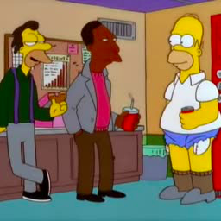

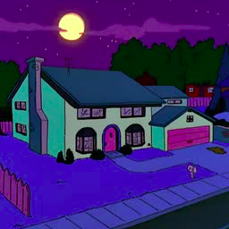
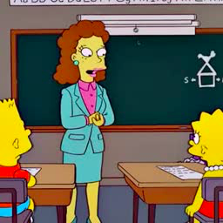
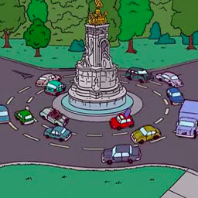
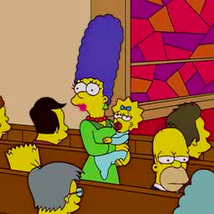
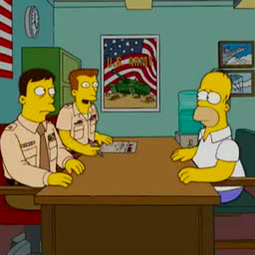
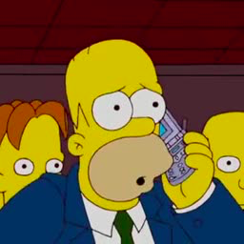
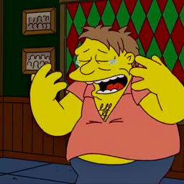
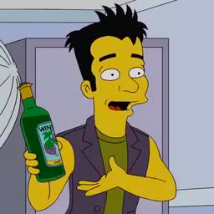
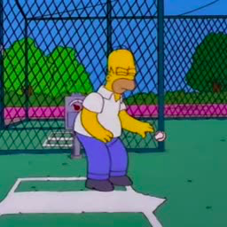
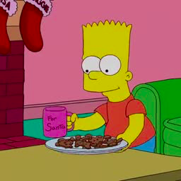
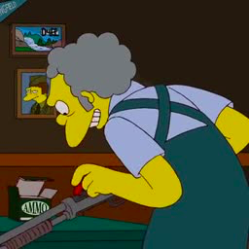
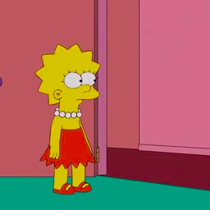
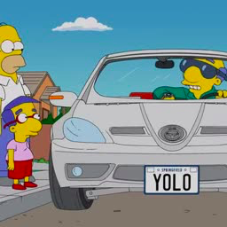

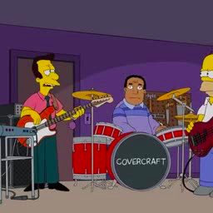
Introduction- Approach/dataset
Implemented a variety of Gans
cGans & patchgan
images from 17 seasons of simpsons
Notes:
Used different types of CGANS and PATCHGAN to try to solve the task at hand.
Our dataset consisted of images from 17 different simpsons seasons.

Slide 4
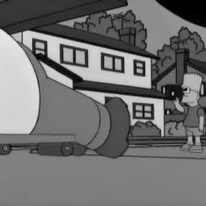
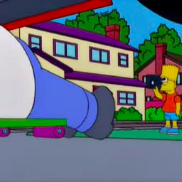
Thesis - Problem statement
Successfully colorize grayscale images from the simpsons Tv series
using: cgans and patchgan
Input
Output
Notes:
Present the problem.
Given a grayscale image hopefully achieve a nice coloured one like in the picture
Skulle gärna ta related work då det hänger ihop med problem statement i deras mall:
The projects objectives are clearly stated. The motivation for pursuing the project and its relevance are clearly and persuasively established by relating the project to related

Slide 5
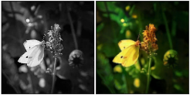
ARGUMENTS - related work : cGAN
CGANS Successfully used to colorize images in Isola et al. (2017)
Input Output
Notes:
Before we look at our solutions, lets look at what has succesfully been used to colorize imgs before
What cgan work Inspired! our work?
Condition on gray scale image. Beautiful results!

Slide 6
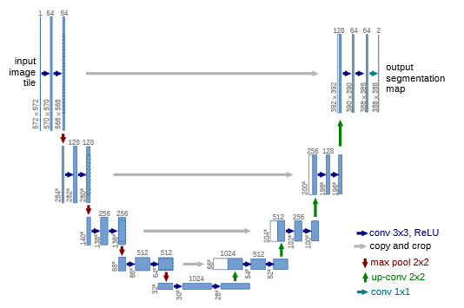
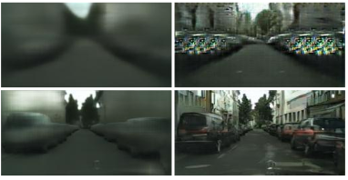
ARGUMENTS - related work : U-net & Skip
U-net architecture and skip connections (Ronneberger et al,2015)
Skip connections increases quality (Isola et al., 2017)
Notes:
In our generator we used a u-net architecture and skip connections.
As you can see U-net gives us a u-shaped generator. Where...
skip connections: connect mirroring layers by concatenation
Peka på bilderna och säg att dom är från Isola (2017)
High-level idea: Keep the structure from previous layers

Slide 7
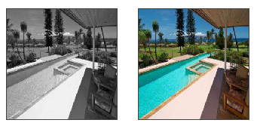
ARGUMENTS - related work : PatchGAN
PatchGAN used to colorize images in Nazeri et al. (2018)
Discriminator outputs 70x70 patches which are then averaged for a final likelihood score
Notes:
PatchGAN produces excellent work as well.
Differs from regular cGAN discriminator which outputs a single scalar
Theory: Instead of outputting one scalar for the entire image, output likelihoods for ‘local patches’. The idea is that these patches
represent the likelihood of corresponding pixels/patches in the output image.

Slide 8
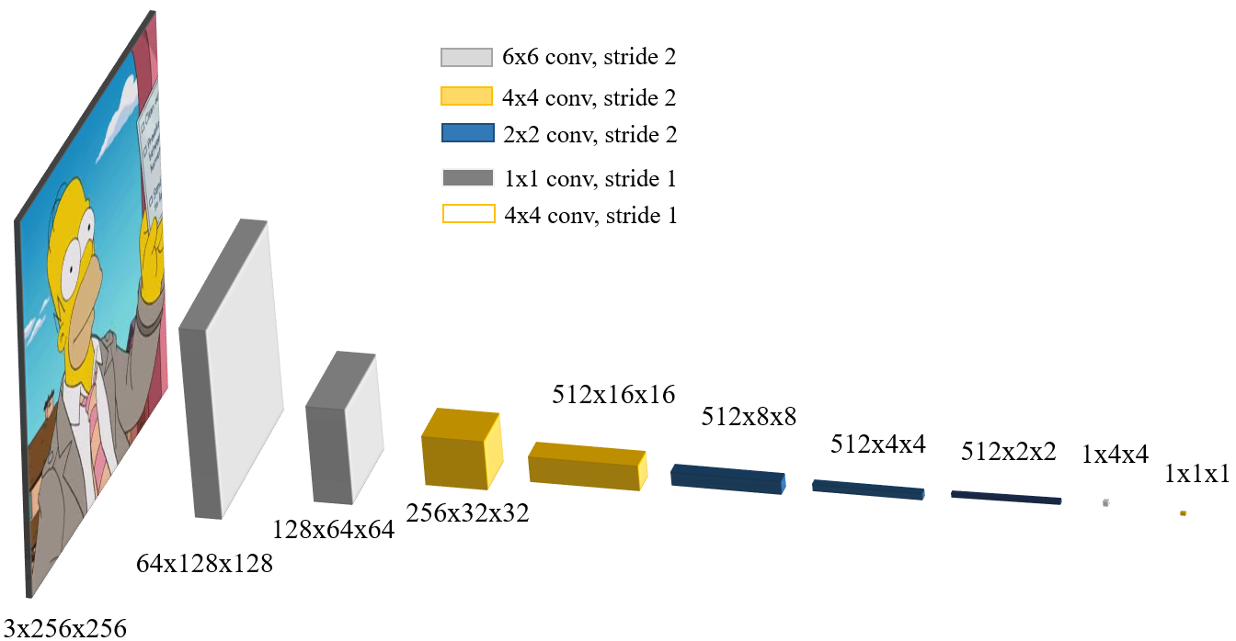
ARGUMENTS - Innovations : Pyramid filters
Previous work (Isola, Nazeri) use constant filter size irrespective of layer
Instead: Use “pyramid” filters that match the size of the input to the layer
Notes:
Point at the pic and explain
Proportional filter size to the input

Slide 9
ARGUMENTS - Innovations : PatchGAN
PatchGAN used in Nazeri et al. ( 2018) averages the patches outputted by the discriminator
Instead: each patch is weighted according to their proximity to the lowest patch likelihood and then summed.
Notes:
Intuition: Instead of focusing on the average, focus on the worst patch.

Slide 10
ARGUMENTS - Innovations : Min-PATCHGAN example
2x2 patch Example:
1. Log the ouput from the discriminator.
2.Calculate weights using softmin. softmin( ) =
3.Multiply the logged output with weights * =
4.sum & calculate exponential to exp(sum( ) ) = 0.18
calculate final likelihood
0.1 | 0.7
0.5 | 0.6
-2.3 | -0,36
-0.69 | -0.51
log ->
-2.3 | -0,36
-0.69 | -0.51
0.67 | 0.09
0.13 | 0.11
0.67 | 0.09
0.13 | 0.11
-2.3 | -0,36
-0.69 | -0.51
-1.5 | -0.03
-0.09 | -0.06
-1.5 | -0.03
-0.09 | -0.06
Notes:
Avg would be 0.475
0.18 likt minsta på 0.1

Slide 11
Solutions - our architectures
cGANs
with pyramid and skip connections
PatchGAN
original average approach avg-PatchGAN
weighted approach min-PatchGAN
4 experiments to find the best performing architecture
Notes:
Overview. Best performing was evaluated by cost graphs & qualitatively by looking at the pictures.

Slide 12
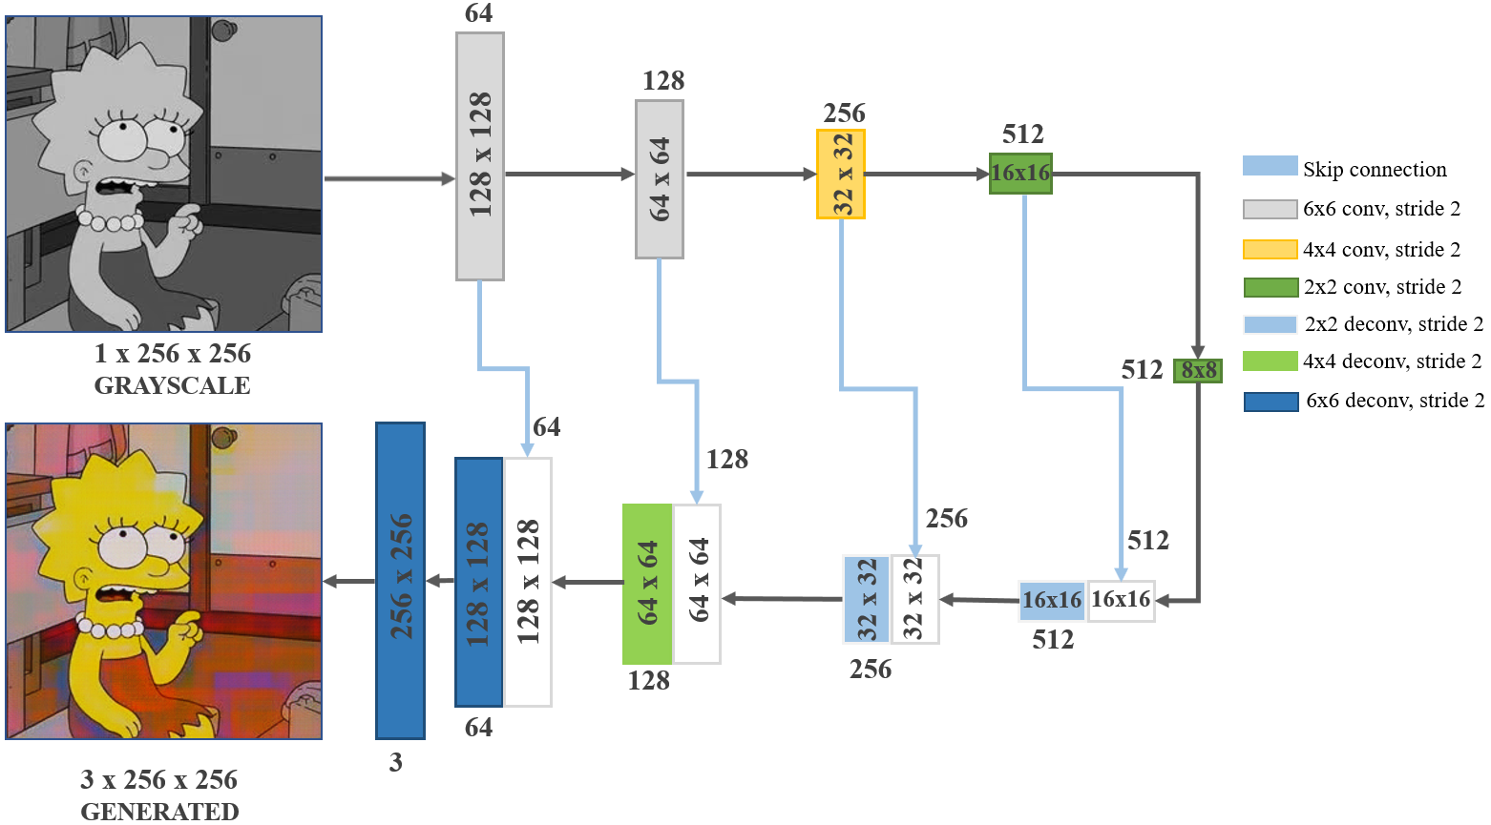
Solutions - Generator architecutre
The same generator was used for both cGAN and patchGAN networks
Pyramid, U-net, Skip conn.
Notes:
U-net & skip from related works. arguments informed our solutions
säg inte det här pga tid (Och batchnormalization, ReLU, transposed convolutions to upsample
Last layer: tanh) DCGAN-pappret motivation

Slide 13
Solutions - cGAN discriminator architecutre
Pyramid filters
Output [0,1]
Notes:
Goes to 1x1 for one final scalar per picture
säg inte det här pga tid (LeakyRELU)
Output is sigmod [0,1]

Slide 14
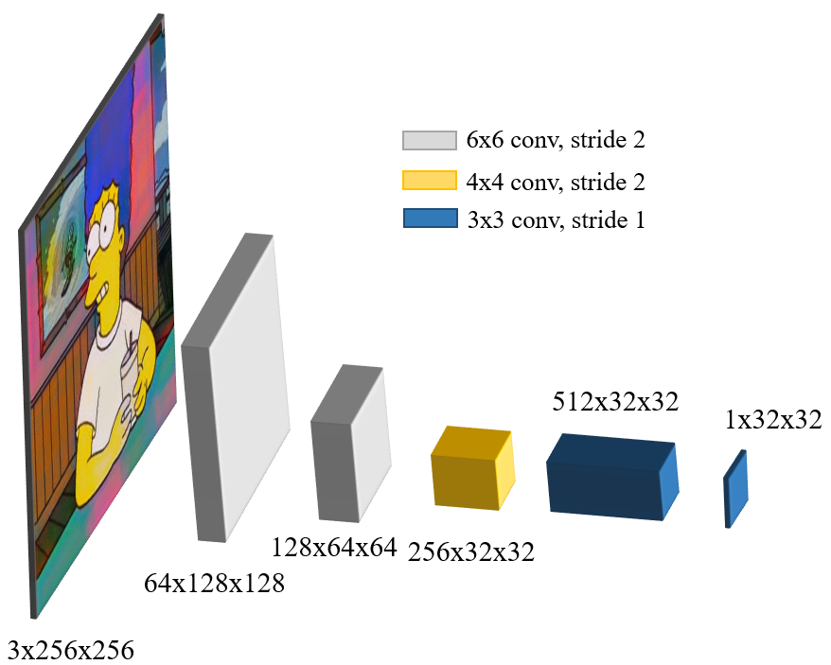
Solutions - patchGAN discriminator architecutre
avg-PatchGAN: Average the 1x32x32 output patches
Min-PatchGAN: each patch is weighted according to their proximity to the lowest patch likelihood and then summed
Notes:
Mention & explain the two different ways of doing it.
INTUITION BEHIND WEIGHTED APPROACH: initially use an ordinary mean patchGAN. Once you have an approximately good solution, start to foucs on the bad areas. (After 5 epochs)
Ouput is [0,1]
Övergång: Now over to the results.

Slide 15
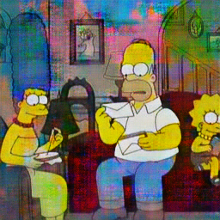
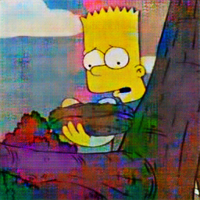
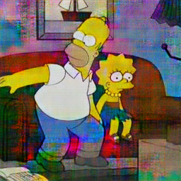
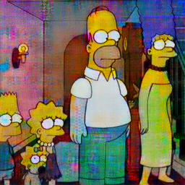
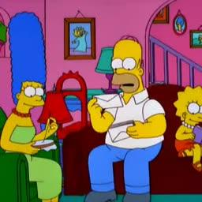
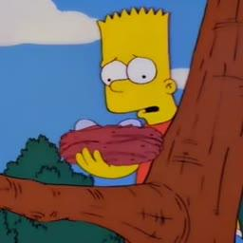
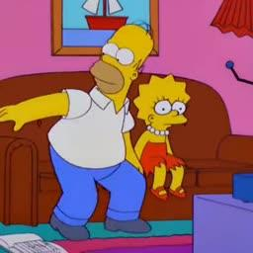
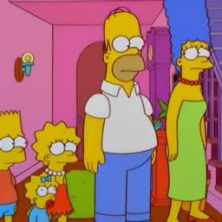
RESULTS - cgan
Notes:
Now i am going to show you our results.
So here are generated images from the best performing cgan architecture which was picked out of 3 different networks.
Peka: results uppe row and generated images lowe.
As you can see it is good at coloring commonly occurring things such as the characters skin color or their clothing ( point to these things).
However, it is less good at giving one object a consistent color. Which you can see here on the wall.
Now moving on to the patchGan results.

Slide 16
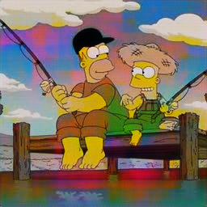
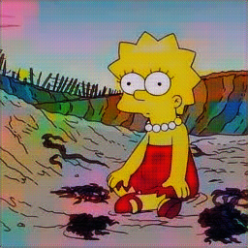
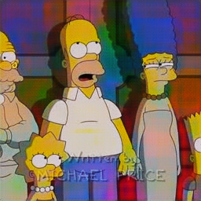
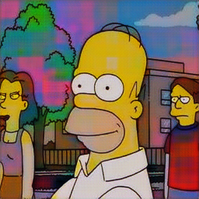
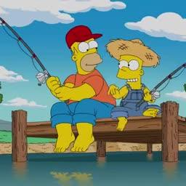
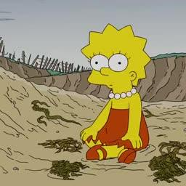
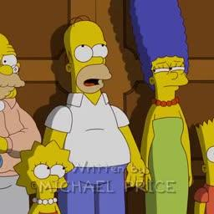
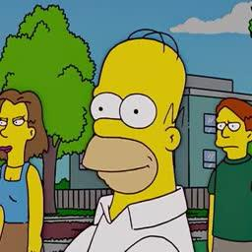
RESULTS - Avg-PatchGAN - original approach
Notes:
Here are the results from the PatchGAN network where we use the approach described in the original PatchGAN paper.
As you can see this network seems to be good at coloring both common objects such as the characters skin, but also things that are less common such as the dock.

Slide 17
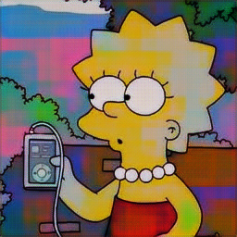
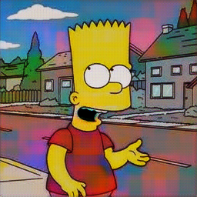
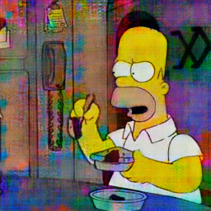
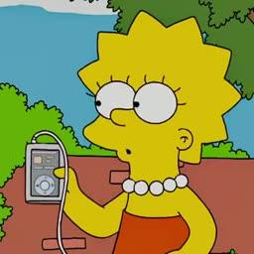
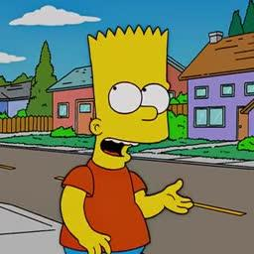
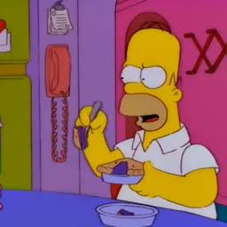
Which network do you think is best? - patchgan or cgan
PATCHGAN
(LEFT)
VS
PATCHGAN
cGAN
(RIGHT)
Notes:
After trying patchGan and a conditional GAN we wanted to try to improve the best performing method even further with a novel approach.
Now we want to ask you. Based on the images showed to you, which method do you think was best? Which one do you think we picked?
On the board we have PatchGAN to the left and a conditional GAN to the right.
Okay lets see which one we picked!
So the reason for why we picked patchGAN was because it was better at giving one object a consistent color.
Also it gave colors which more closely resembled the ground truth colors.

Slide 18
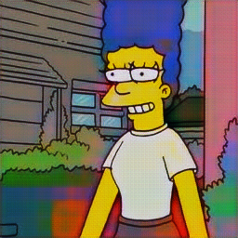
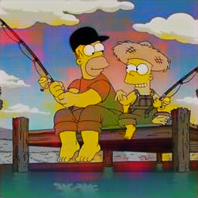
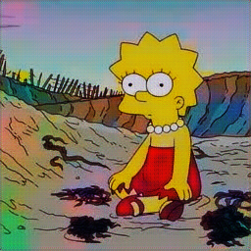



RESULTS: MIN-PatchGAN(upper) vs. Avg-PatchGAN (LOWER)
Notes:
So, as Jacob described we implemented a weighted version of PatchGAN. So here on the upper part of the board we can see generated images from our weighted version after 15 epochs
and on the lower half of the screen we see colorized images from a ordinary patchGAn.
Picture 1 (marge): here we can see that the red area has decreased and blue on house door gone. Green has resided on bush.
Picture 2 (brygga): Here the red in the water has started to disappear in Min-patch. Also there is less red in the sky.
Picture 3 (Lisa): Pink in the sky, green on ground and gray in her hair has started to disappear. However also more blue and green on ground.
Picture 3 (Bart): The read and green patch areas on the mountain has disappeared.
Moving on to our conclusion.

Slide 19
conclusions
Both cgans and pAtchgan proved to be successful in colorizing simpsons grayscale images.
Skip connections and pyramid shaped filters resulted in qualitative images.
Best results was achieved by our min-patchgan architecture.
Cannot colorize perfectly.

Slide 20
Deep learning skills - Alexandra hotti
Comprehending cGANs, GANs and PatchGANs and their differences.
Practical implications of training a gan
Time consuming - finding optimal solution is hard.
Pytorch - easy implement, GCP implementations possible
Gan optimization techniques.
non standard approach: patchgan improved the most.

Slide 21
Deep learning skills - JAcob malmberg
an Understanding of GAN, cGAN, PatchGAN
Needed to implement this project
Training a GAN using PyTorch
Implemented in Pytorch
Baseline GAN does not always work - customization needed
PatchGAN (patch size), Pyramid filters

Slide 22
Deep learning skills - Marcus Nystad öhman
an Understanding of GAN, cGAN, PatchGAN
A skill required to implement this project
Training and implementation of a GAN using PyTorch
used pytorch for implementation
Bashscripts to effectively use GCP
GAn optimization - Customized solutions
Min-PatchGAN, Pyramid filters

Slide 23
Appendix
LAB color space
cost graphs - AVG-PatchGAN
cost graphs - MIN-PatchGAN
cost graphs - cGAN
cGAN networks: Nw1, Nw2, Nw3
RESULTS: MIN-PatchGAN and Ground Truth

Slide 24




LAB - COLOR space
Unstable Discriminator cost plot.

Slide 25


cGAN Cost graphs
Discriminator Generator

Slide 26


Avg-PatchGAN Cost graphs
Discriminator Generator

Slide 27


Min-PatchGAN Cost graphs
Discriminator Generator

Slide 28






The 3 different cgan networks - at epoch 10
Three different architectures for the cgan networks were trained up until epoch 10. These had:
different filter sizes,
skip connections/no skip connections.

Slide 29


RESULTS: MIN-PatchGAN and Ground Truth

